Slide 1












UNIC BIP’s : Learning opportunities to get « engaged »
FOREU4ALL Webinar: BIPs in the Context of European University Alliances
18 September 2025

Slide 2

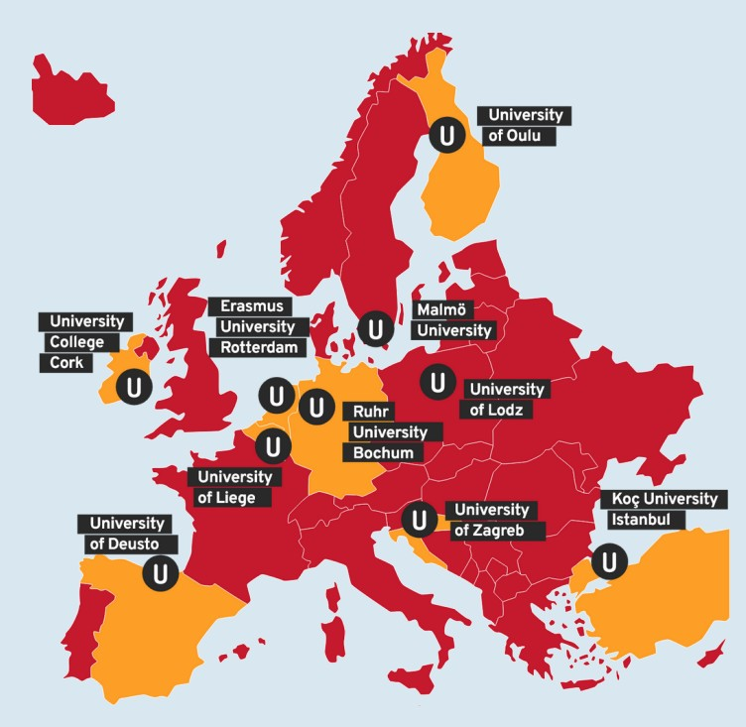

UNIC, our European University
The European University of Post-Industrial Cities (UNIC) consists of ten universities situated in different countries throughout Europe, representing ten different post-industrial cities, faced with challenges of transition.
A network of Universities but also of Cities !
  ​
Deliverable Title
//2

Slide 3
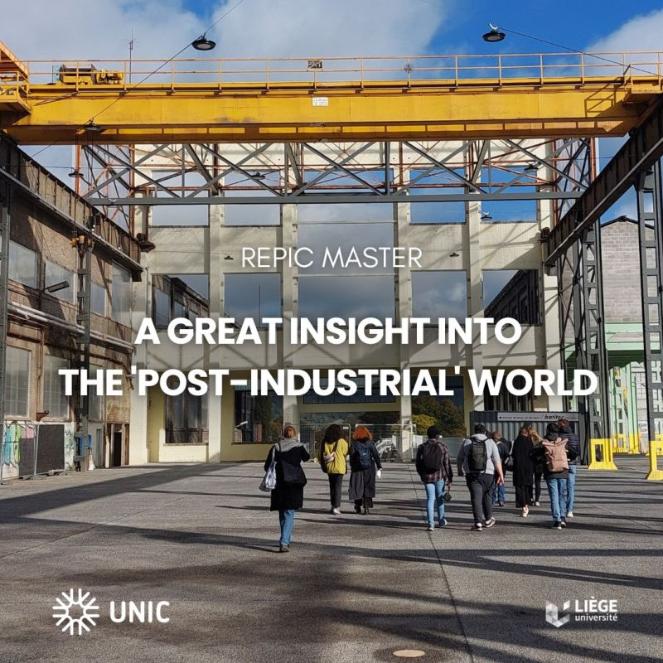
UNIC, our European University
The European University of Post-Industrial Cities (UNIC) consists of ten universities situated in different countries throughout Europe, representing ten different post-industrial cities, faced with challenges of transition.
A network of Universities but also of Cities !
  ​
Deliverable Title
//3

Slide 4
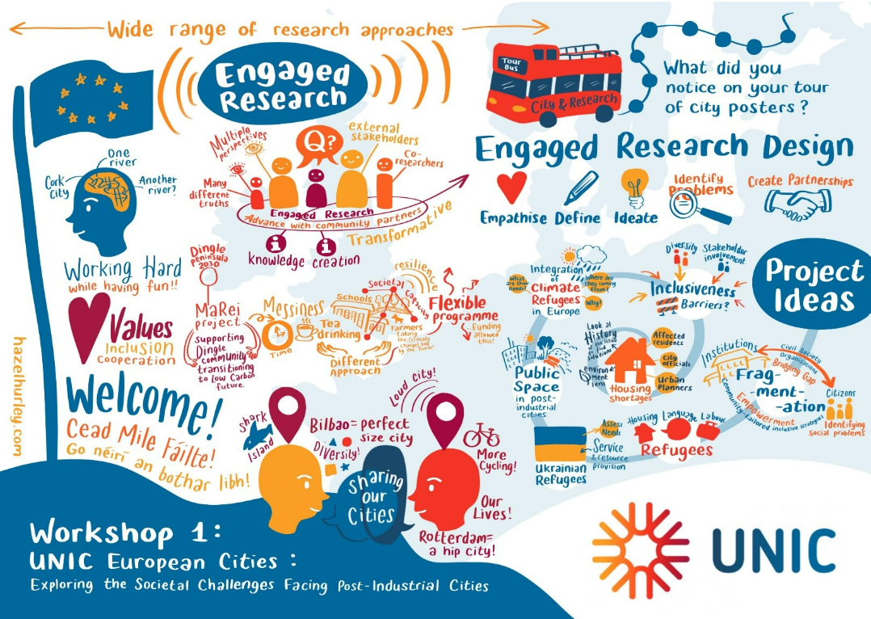
UNIC Engaged research & Challenge based learning
A unifying framework for research policies and systems that puts the engagement and involvement of citizens, civil society, and public/cities at the heart of delivering excellence in research and innovation for societal impact.
…being entangled with actual challenges and people.
  ​
Deliverable Title
//4

Slide 5
UNIC Engaged research & challenge based learning
Challenge-Based Learning (CBL) is
a teaching and learning strategy where students, with support from teachers and experts, identify complex real-world challenges and collaboratively develop innovative solutions.
  ​
Deliverable Title
//5

Slide 6
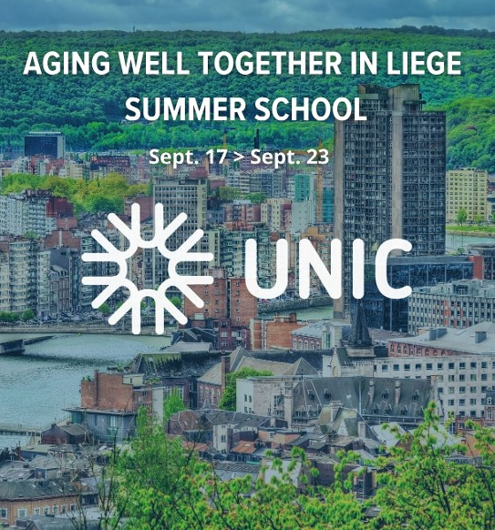
Summer School “Ageing Well Together in Liège”
“We believe that aging well in place, and specifically in post-industrial, super-diverse contexts, calls for multi-disciplinary research and co-design of end-users’ driven solutions. This one-week, charge-free Summer School will bring together academics and specialists from health (nursing) sciences, gerontology and gerontechnologies, well-being, intergenerational solidarity and migration, leisure for older adults, communications and engineering, architecture and urbanism, epidemiology, cognitive functions, participatory design… which all will contribute to the multi-disciplinary coaching of the participants.”
  ​
Deliverable Title
//6

Slide 7
Summer School “Ageing Well Together in Liège”
More than 30 Participants from 5 UNIC Universities ;
13 fields of expertises ;
An Existing MOOC for the online component;
5 days of intense collaborative work, encounter with stakeholders and citizens, field visit, presentations and lectures.
  ​
Deliverable Title
//7

Slide 8
Summer School “Ageing Well in Liège”
8 Challenges :
Rethinking an every-day life with Disability
An App for lonelisness intervention
Honor the perspectives of Marginalized elders
Resilience for slight cognitive impairment
Memory and aging well
Re-designing the museum experience
Re-designing the shopping cnter experience
Friendly/Unfriendly living envripnments for ageing : a heat map
Stakeholders and citizens available to work on every challenge.
  ​
Deliverable Title
//8

Slide 9
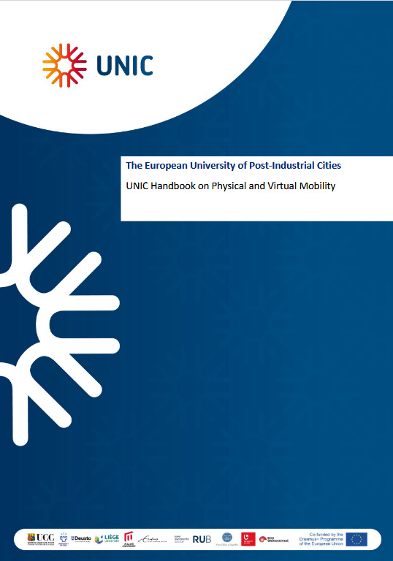
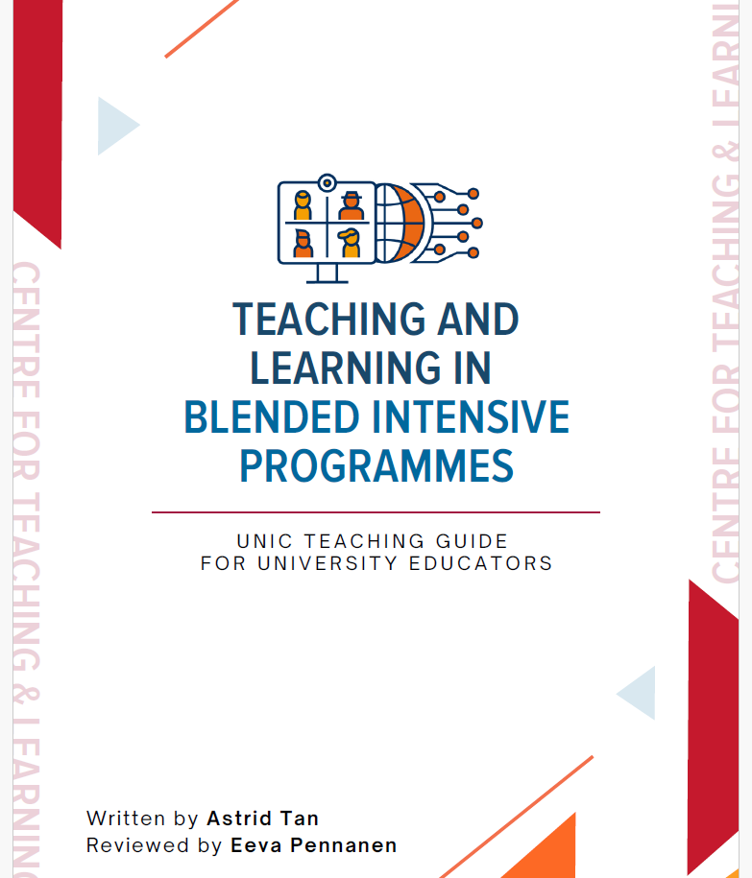
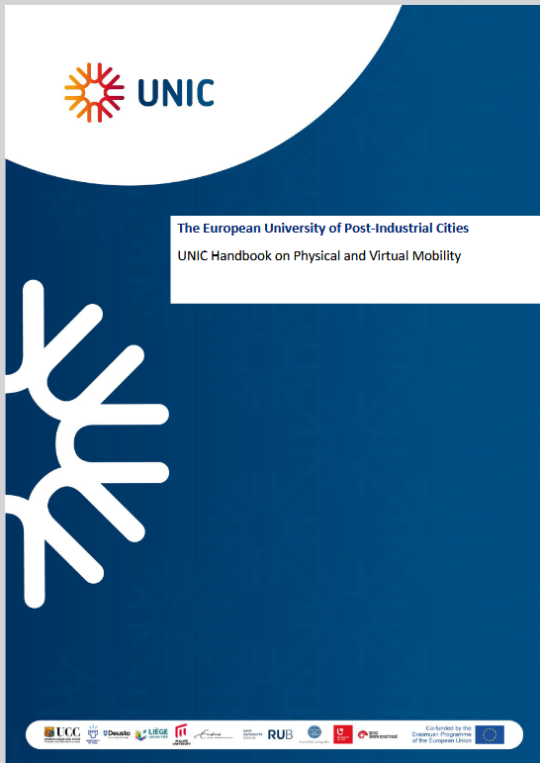
Ressources
The UNIC Handbook on Physical and Virtual Mobility.
Teaching and Learning in Blended Intensive Programmes
UNIC Engaged research strategy
Deliverable Title
//9

